Slide 1
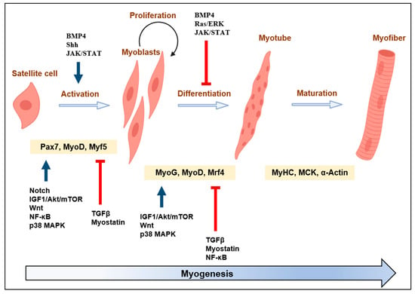
Notes:
From:

Slide 2
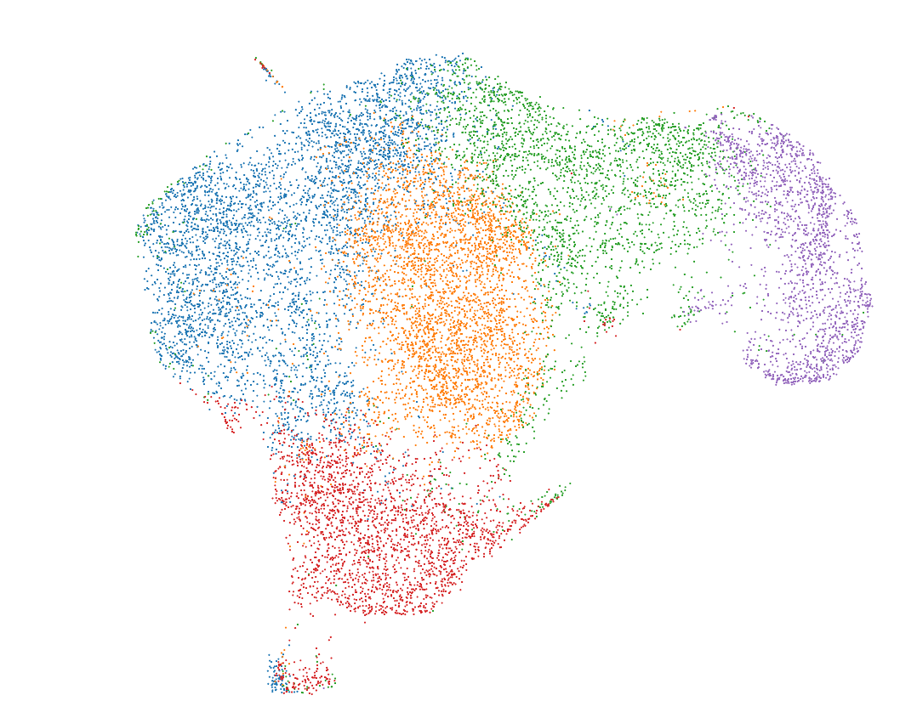
Day 8
RNA UMAP + K-means clustering (k=5)
Notes:
From the 10X pipeline

Slide 3
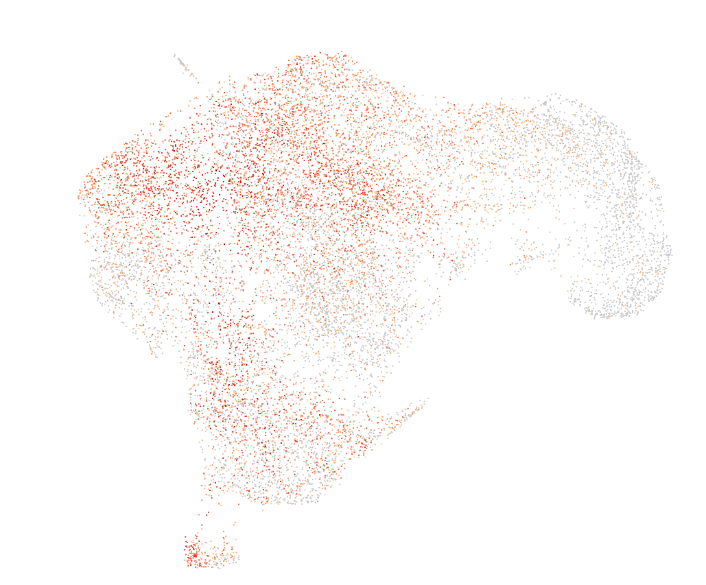
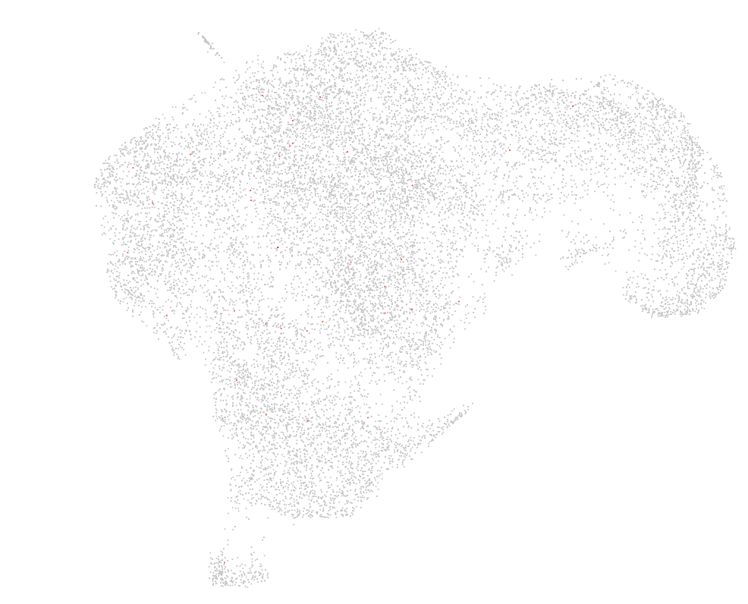
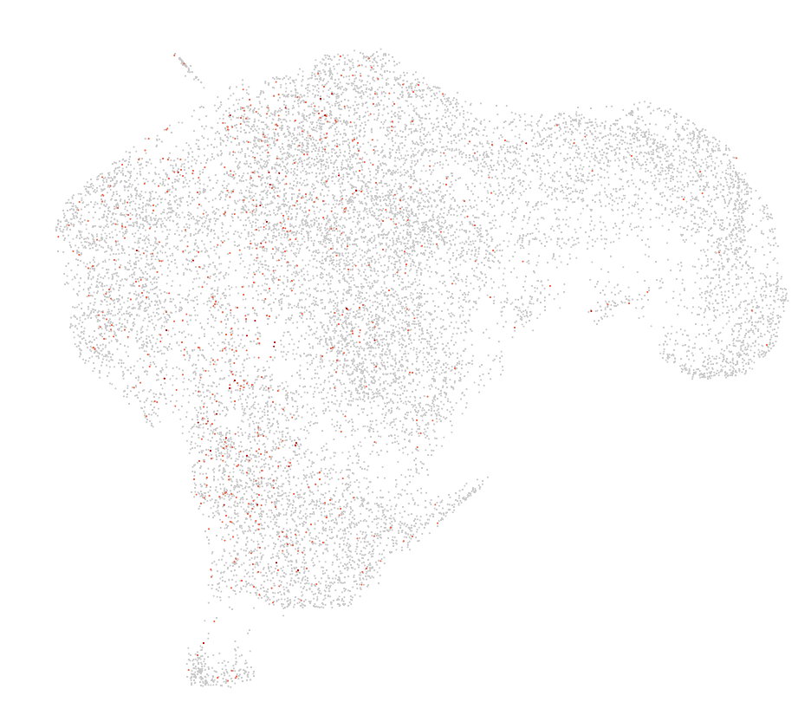
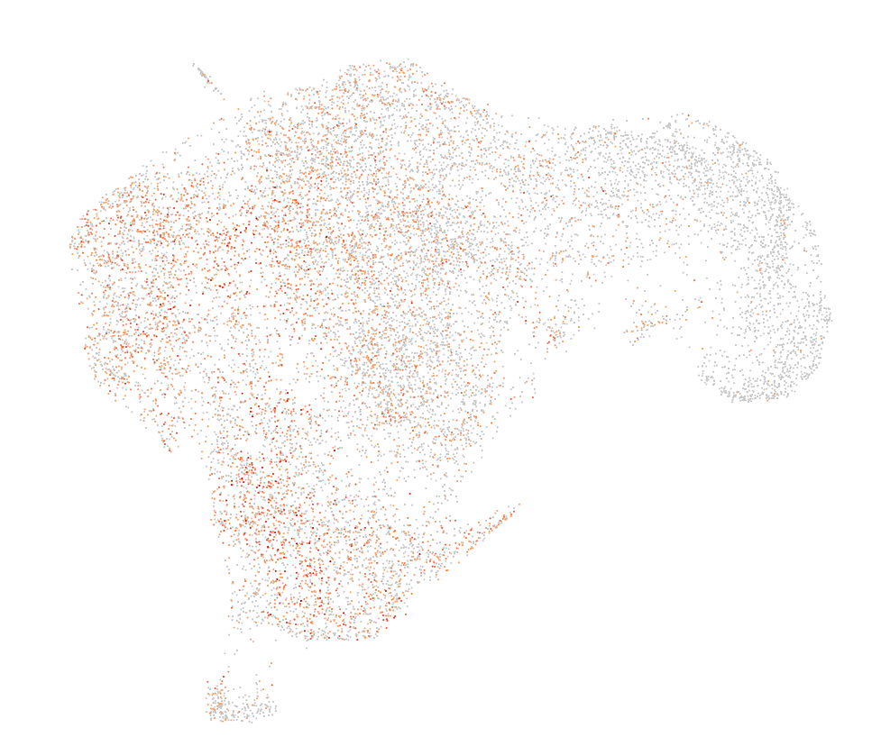
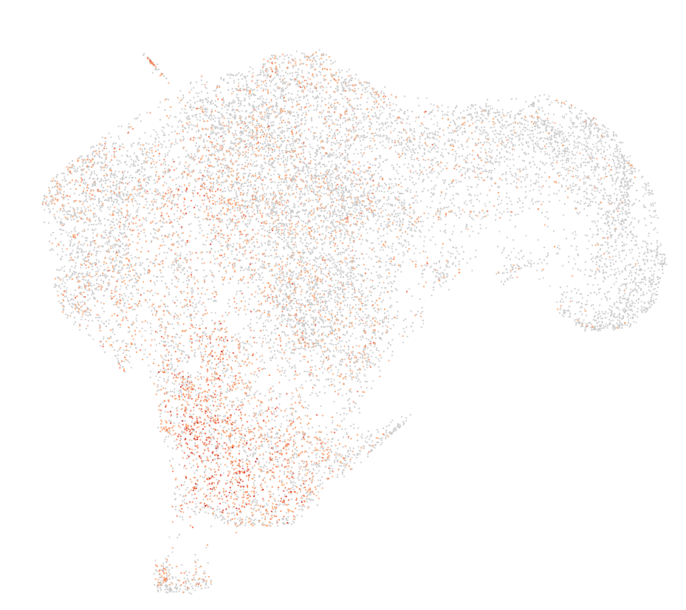
Day8: Initial analysis mucles cells markers
Cluster assignments
PAX3
PAX7
MYOD1
MYOG
OGN
PDGFRA
HEY1
Notes:
No expression of muscle cell markers (PAX7, MYOD1,…), but a bit of the OGN PDGFRA -> messenchymal

Slide 4
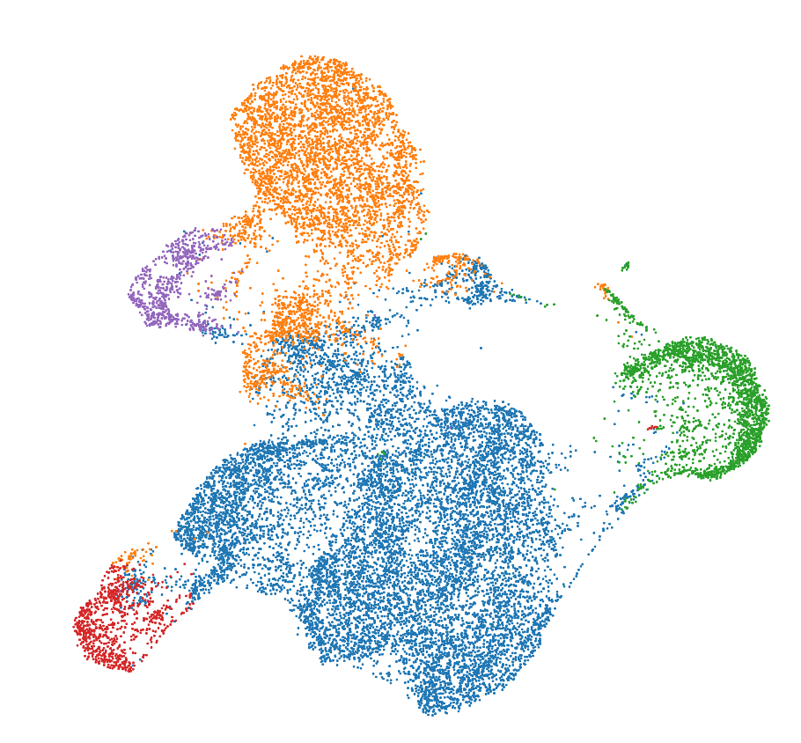
Day 12
RNA UMAP + K-means clustering (k=5)
Notes:
From the 10X pipeline

Slide 5
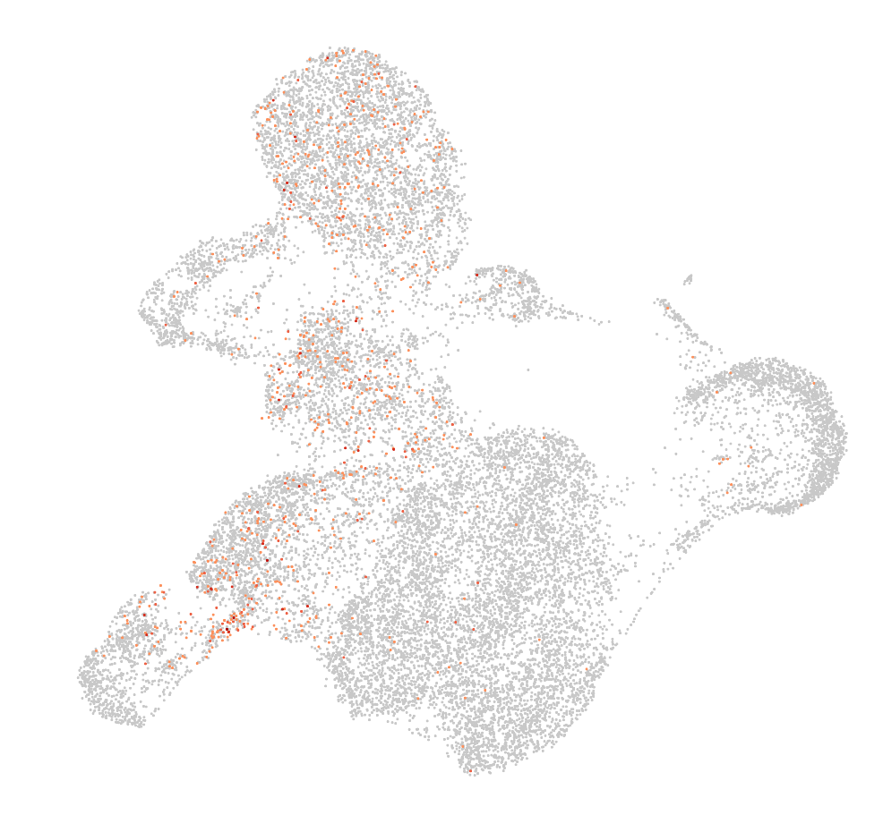
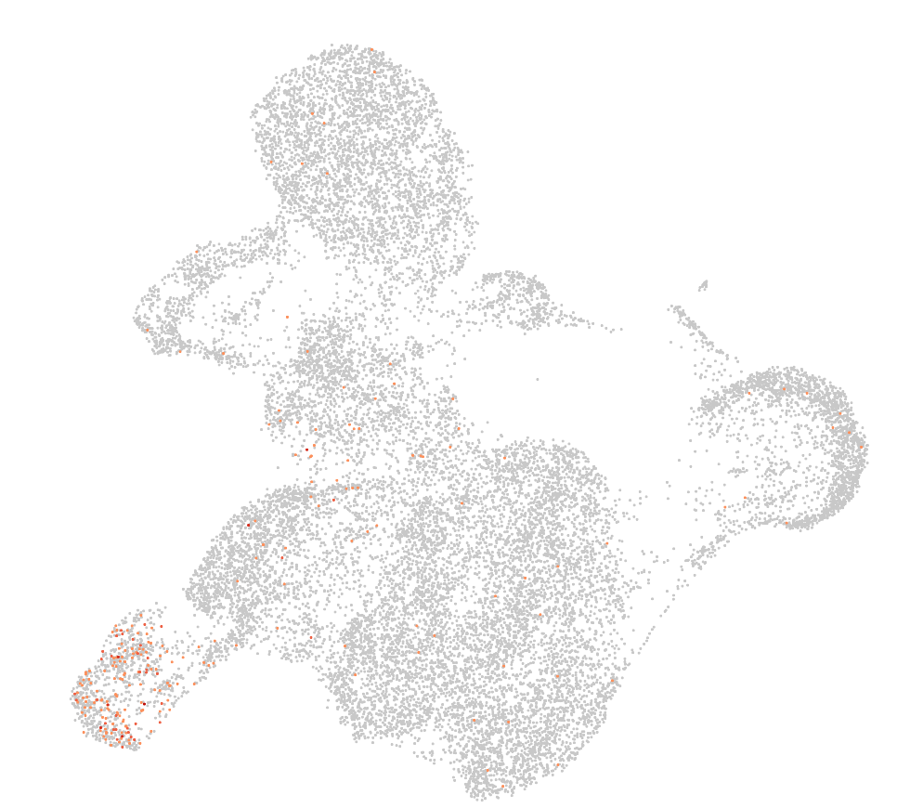
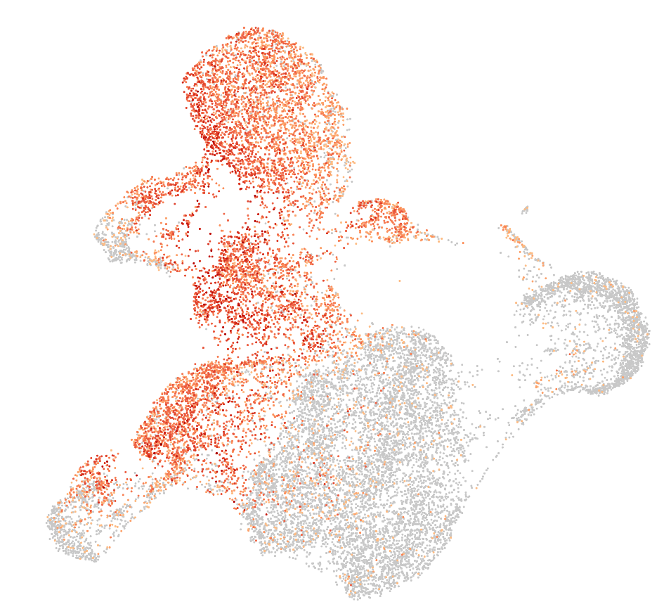
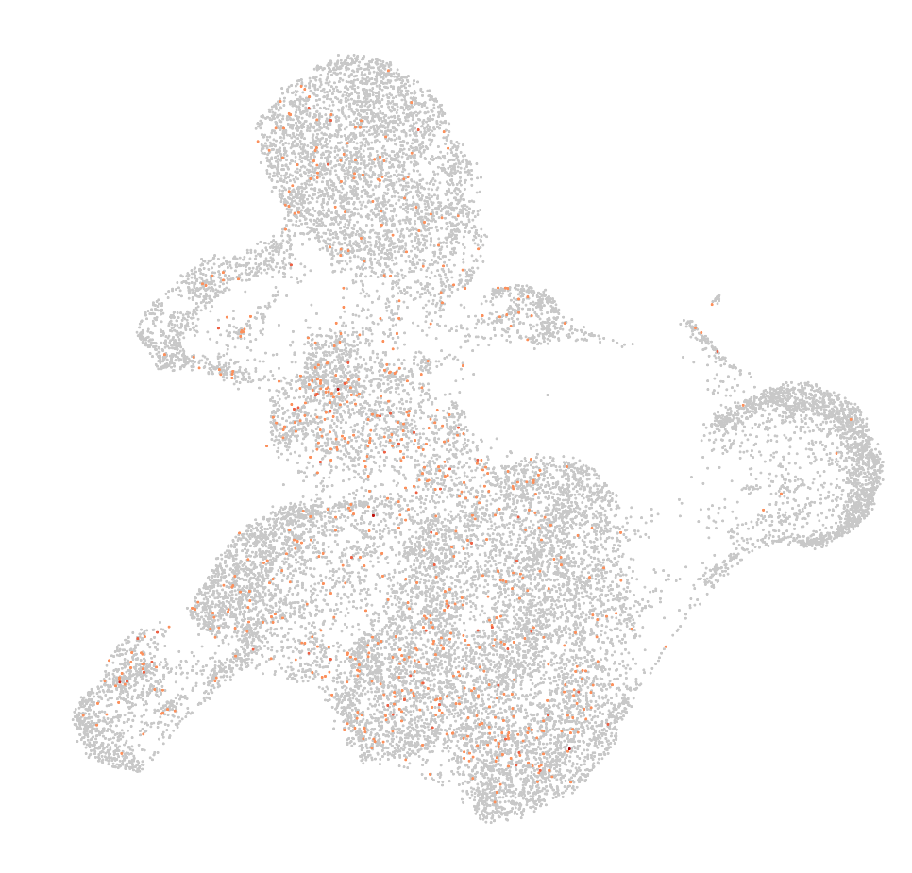
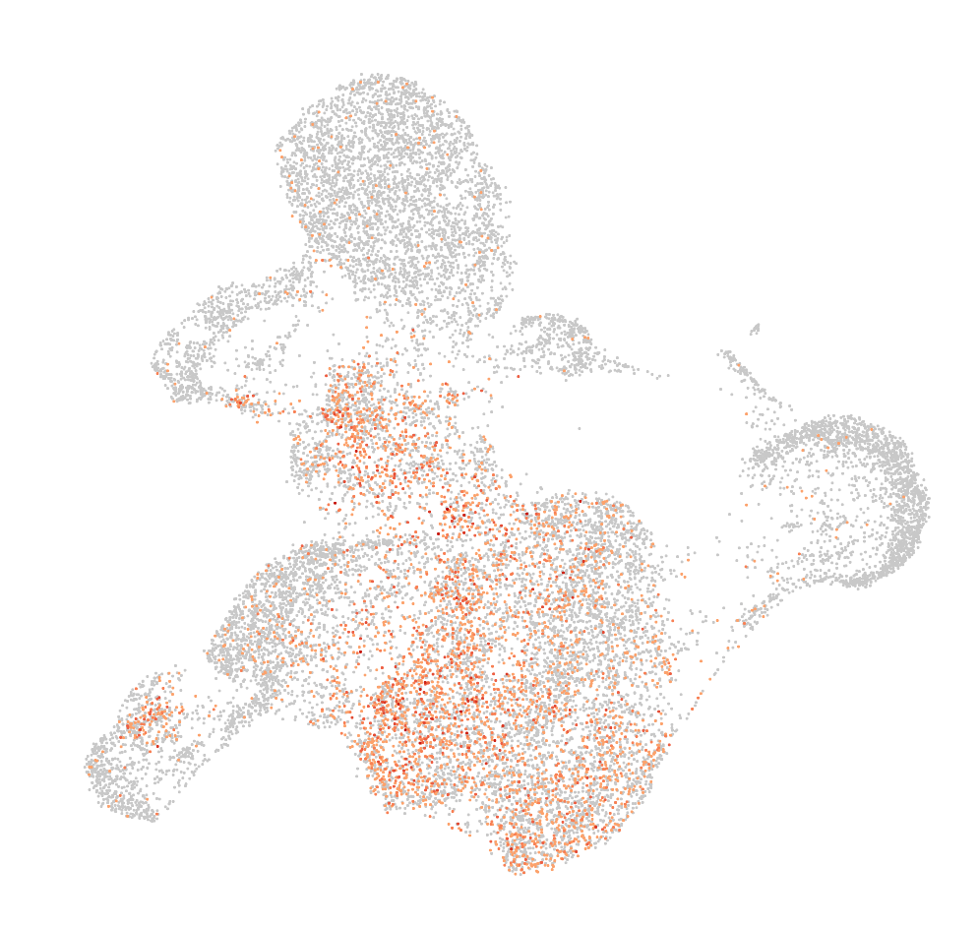
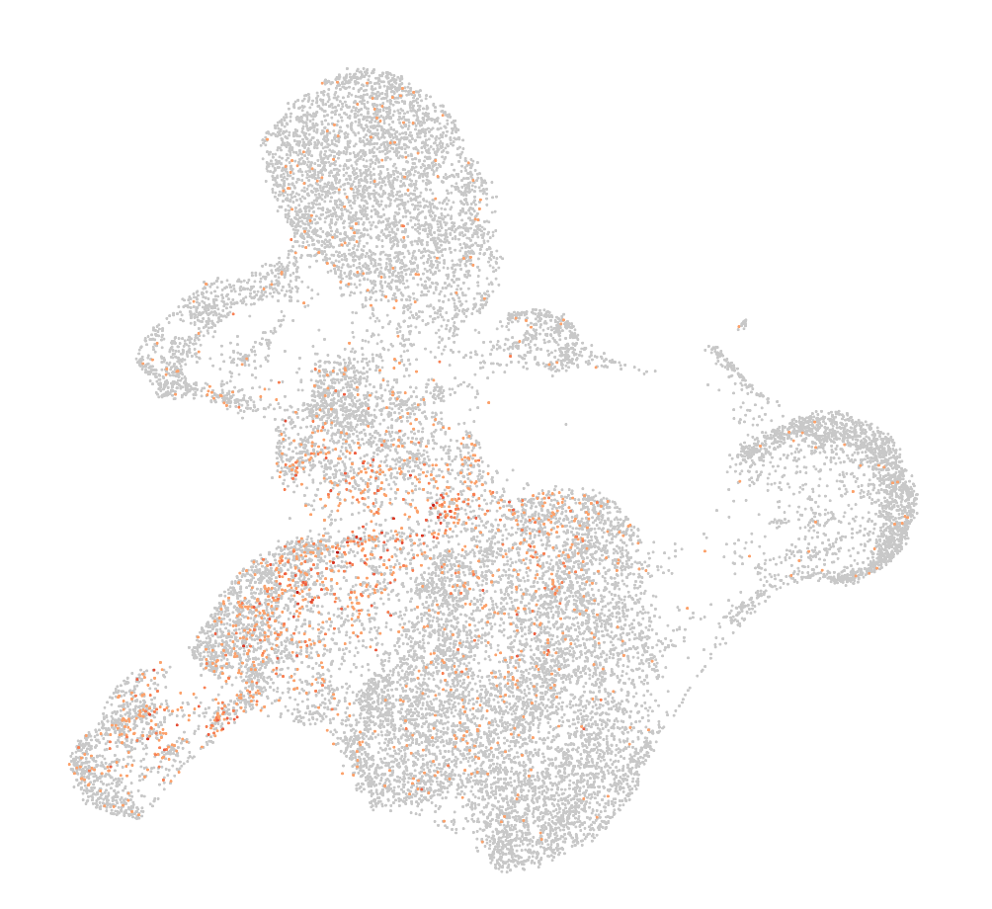
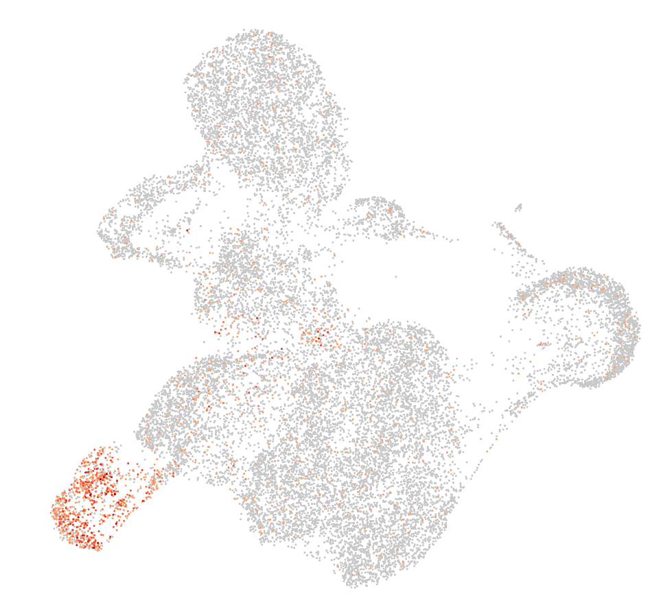
Day12: Initial analysis mucles cells markers
Cluster assignments
PAX3
PAX7
MYOD1
MYOG
OGN
PDGFRA
HEY1
Notes:
No expression of muscle cell markers (PAX7, MYOD1,…), but a bit of the OGN PDGFRA -> messenchymal

Slide 6
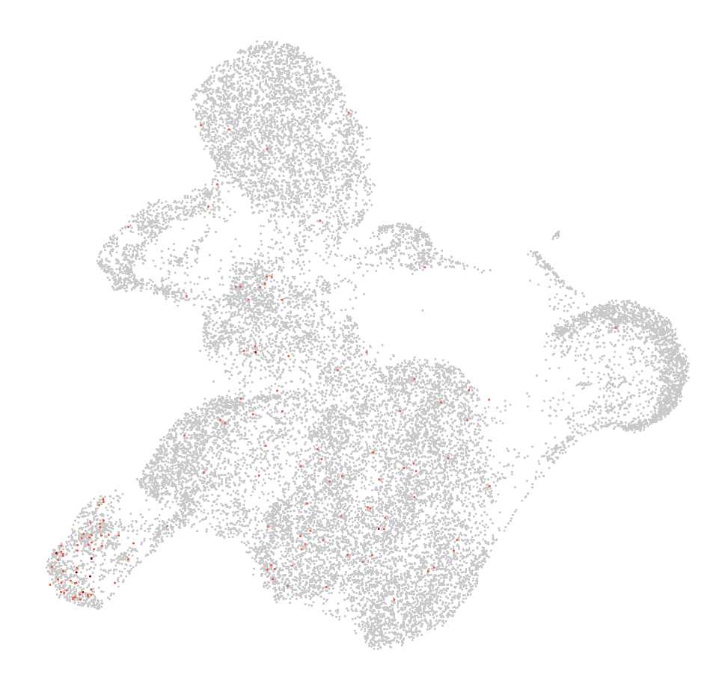
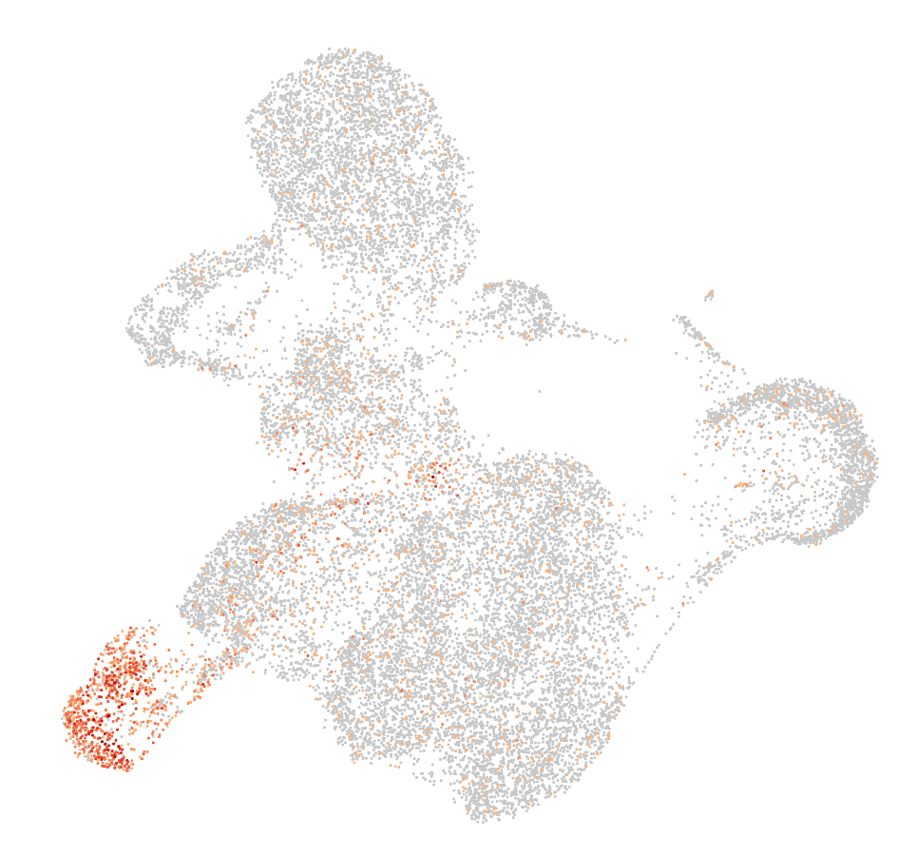
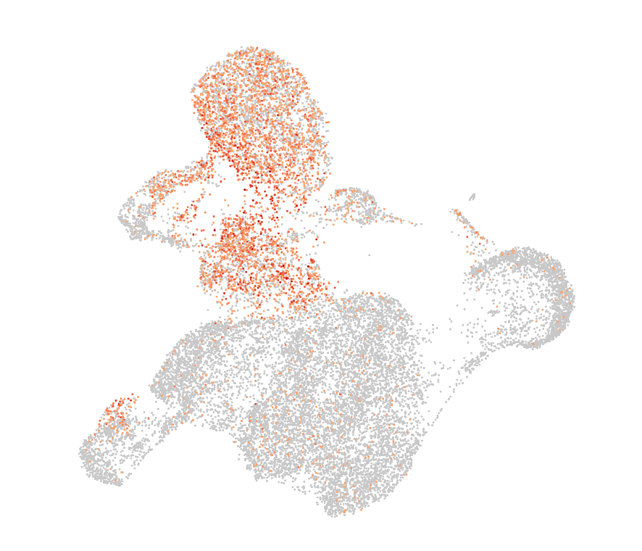
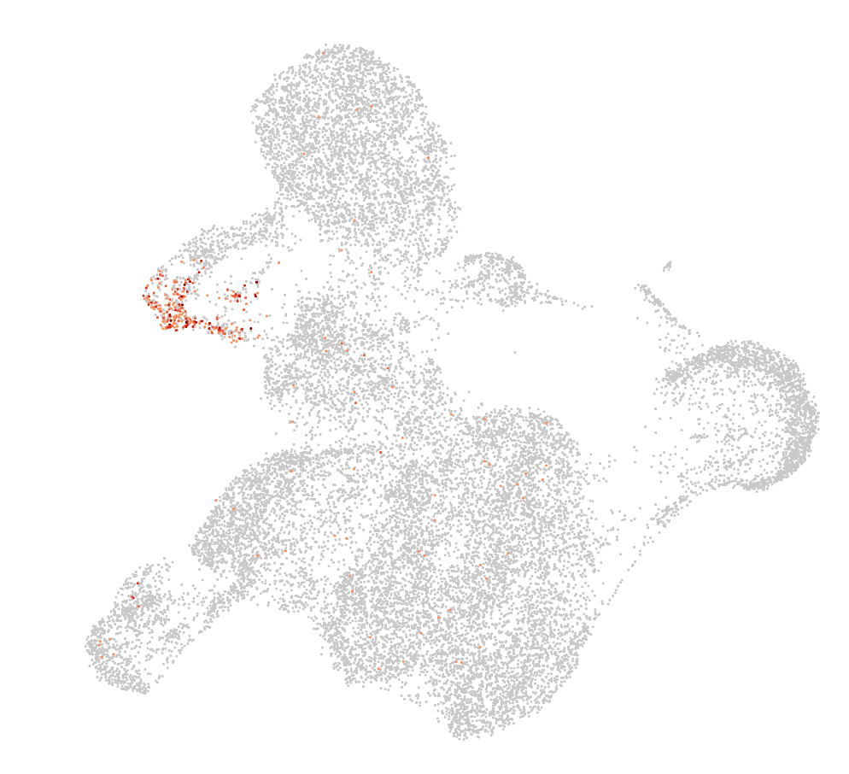
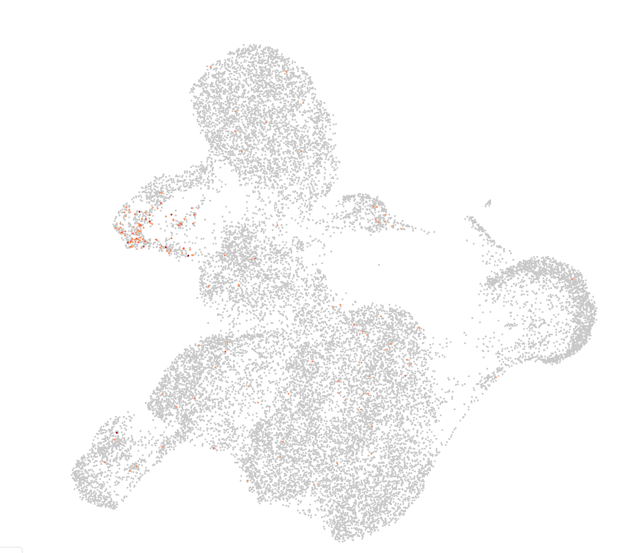
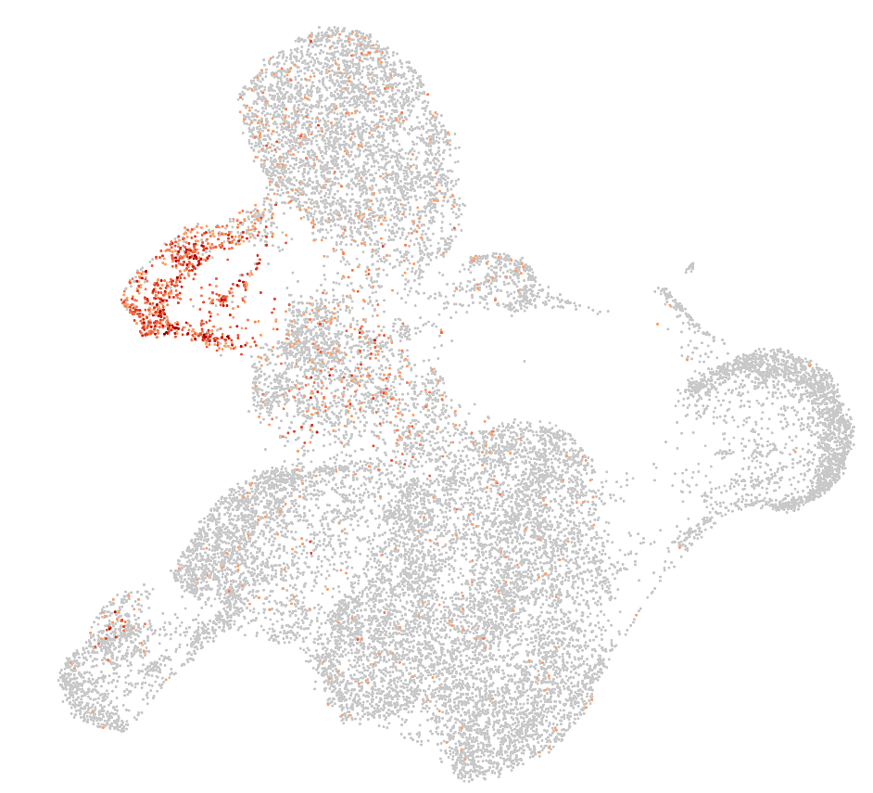
Day12: Initial analysis mucles cells markers
Cluster assignments
CKM
SOX2
TNNT1
MYT1L
GRIA2
SRRM4
-> associated with neuronal tissues
Notes:
First row more muscle cell markers
Second row top 3 differently expressed gene in green cluster -> associated with neuronal tissues

Slide 7
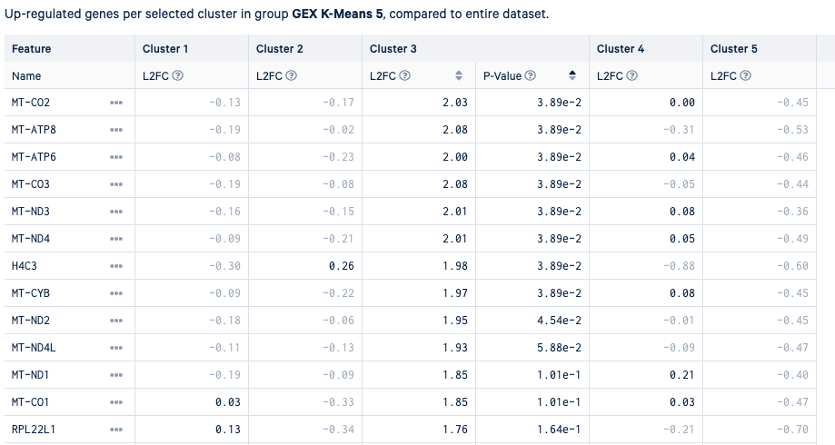
Mitochondrial cell almost all differently expressed genes ->
dead cells?

Slide 8
Day12
Myogenetic progenitors
Neuronal tissues
Dead cells
Myoblast
Skeletal Mesenchymal
Myocytes + myotube
Notes:
Blue probably at leat two clusters ->

Slide 9
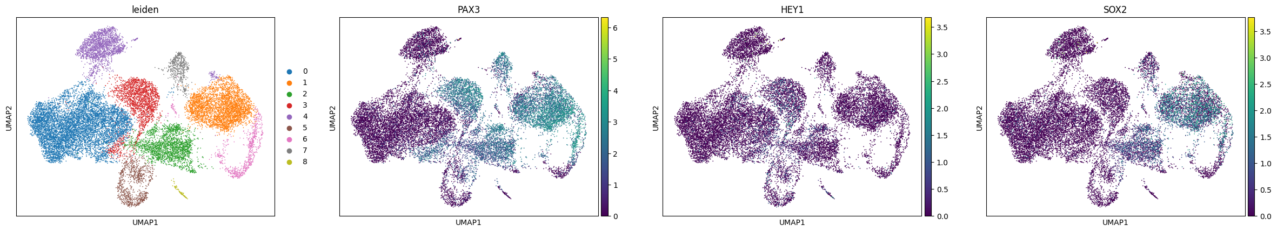
Day12: scanpy clustering
Not really conviced by quality of clustering -> Did not do any filtering of cells + high mitochondrial genes counts
=> Probly not great idea to interpret what we see here and derive clusters

Slide 10
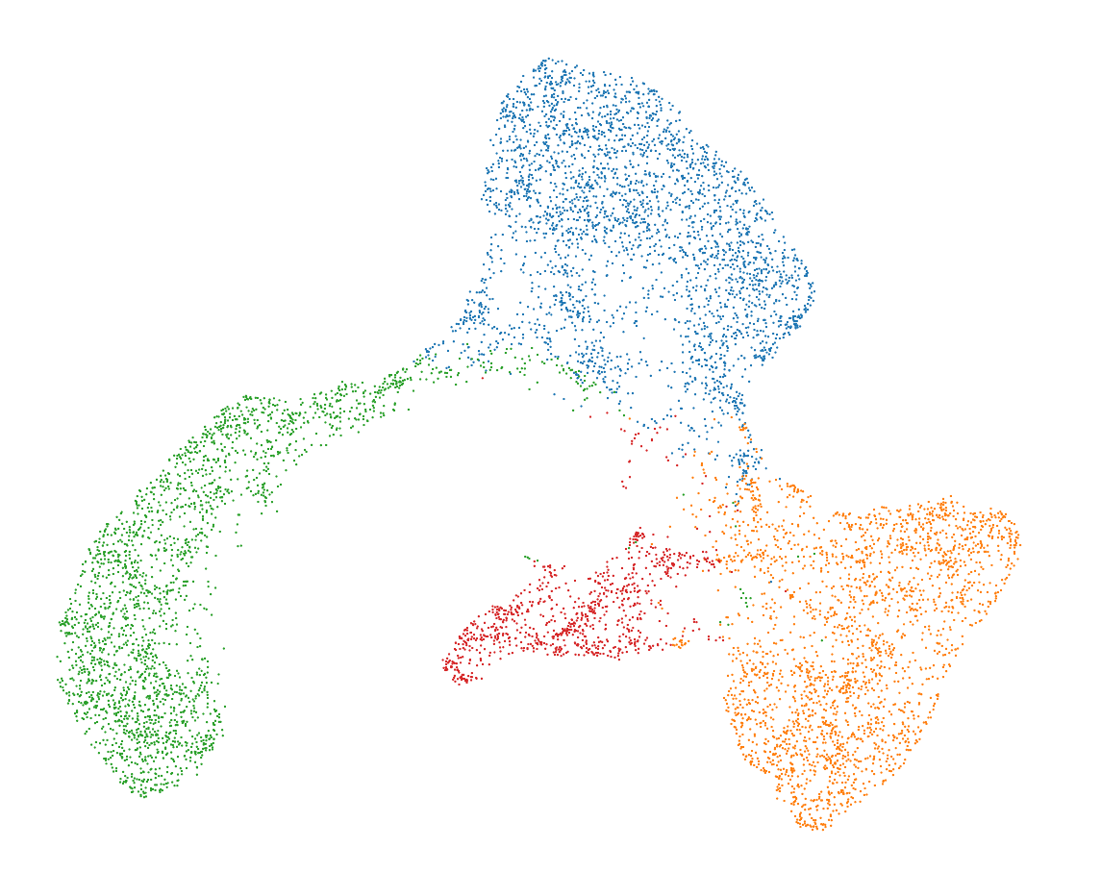
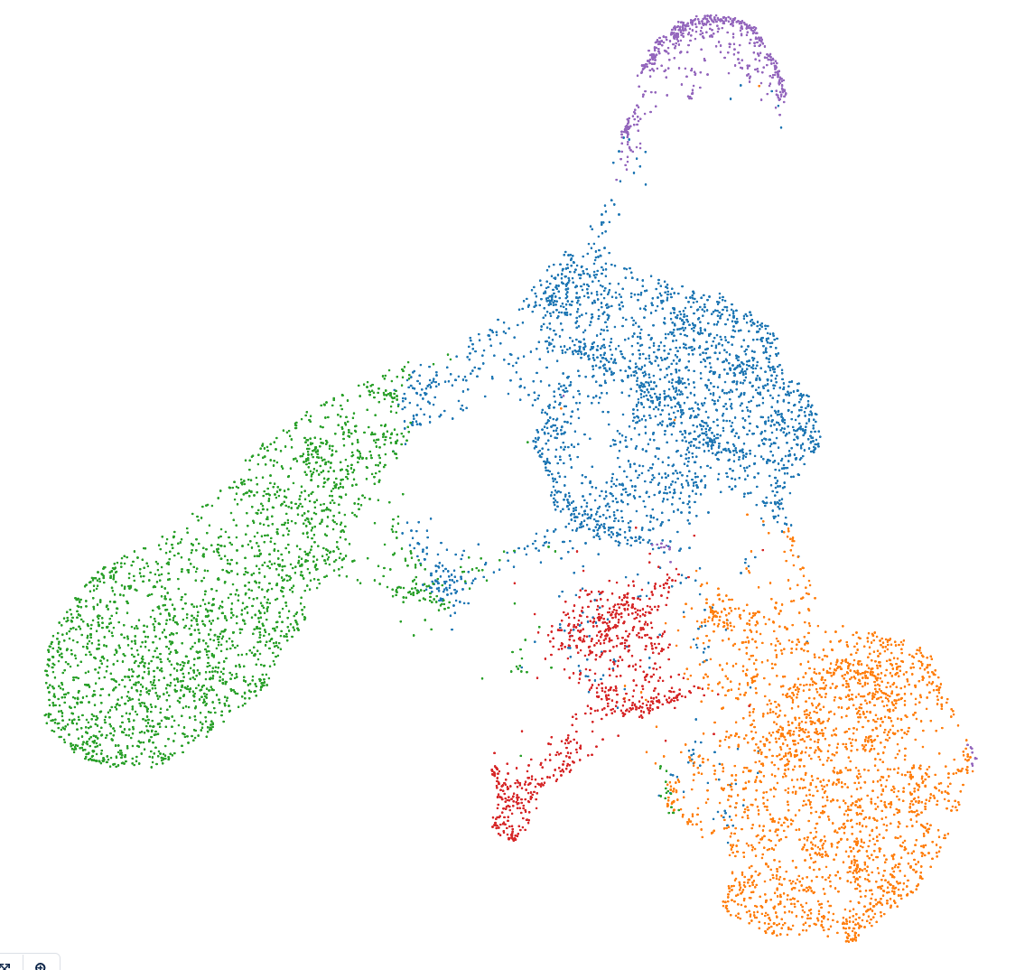
Day 22
ATAC UMAP + K-means clustering (k=4)
RNA UMAP + K-means clustering (k=5)
Notes:
From the 10X pipeline

Slide 11
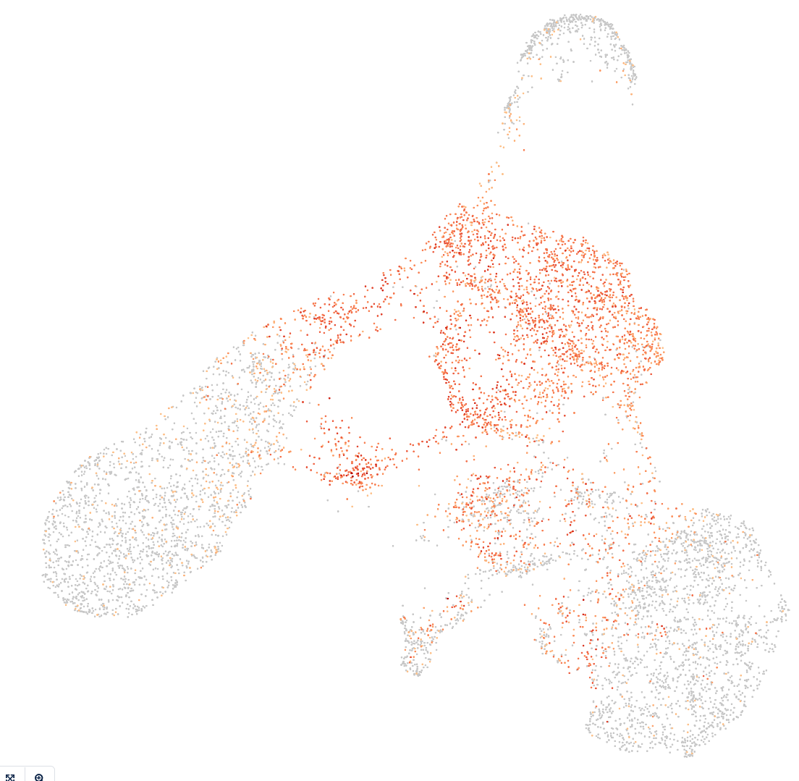
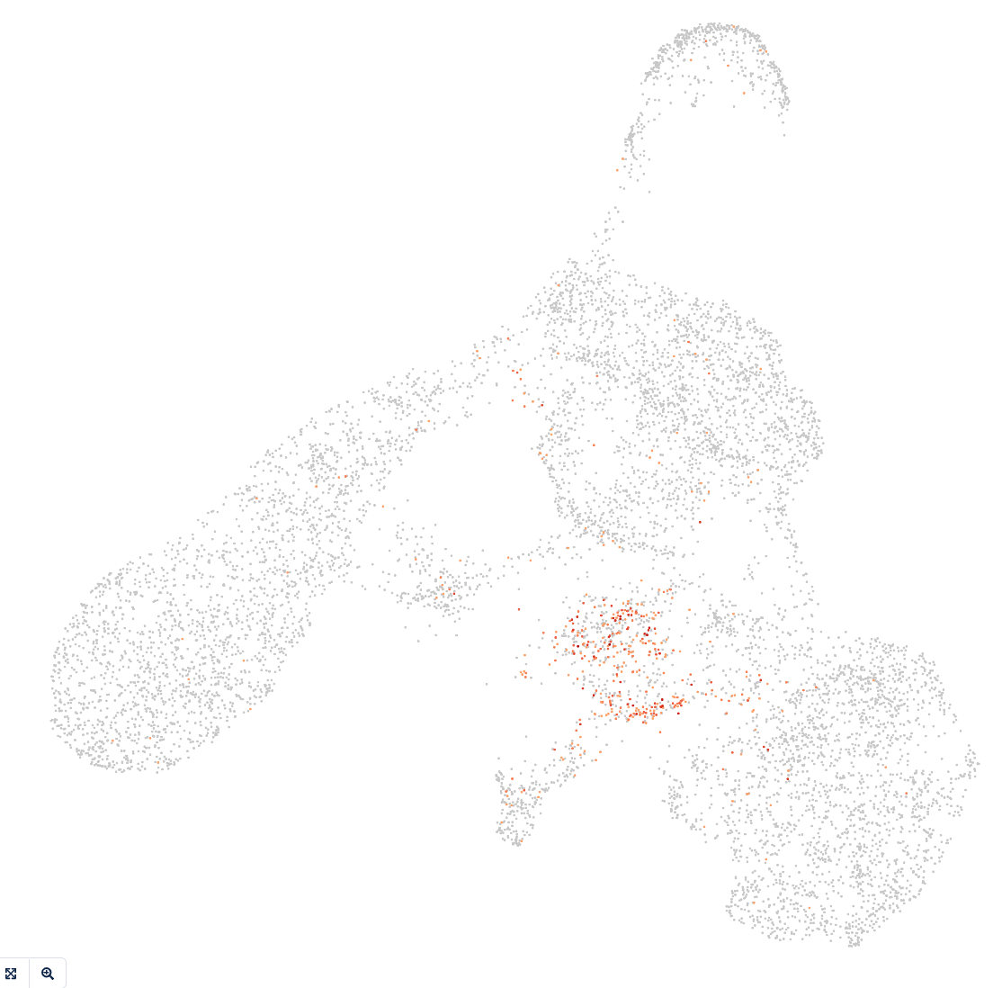
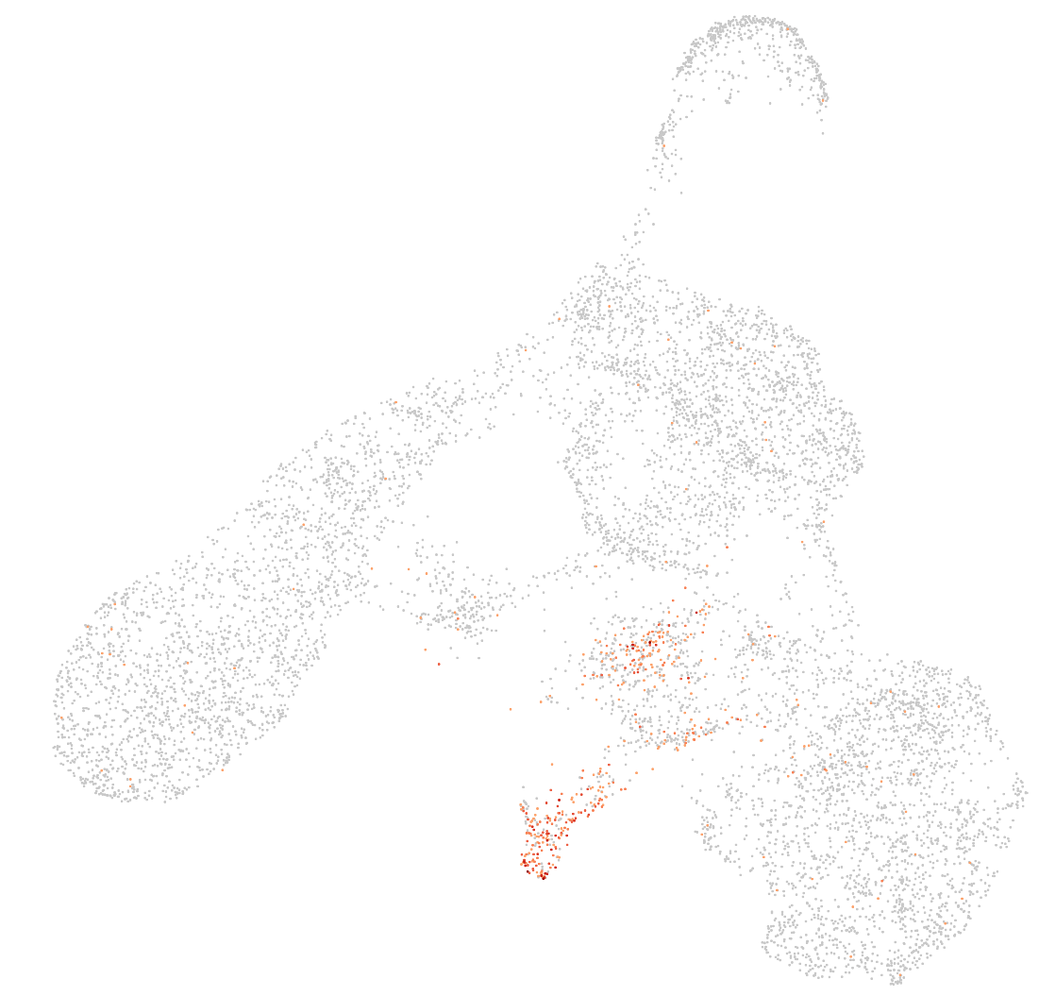
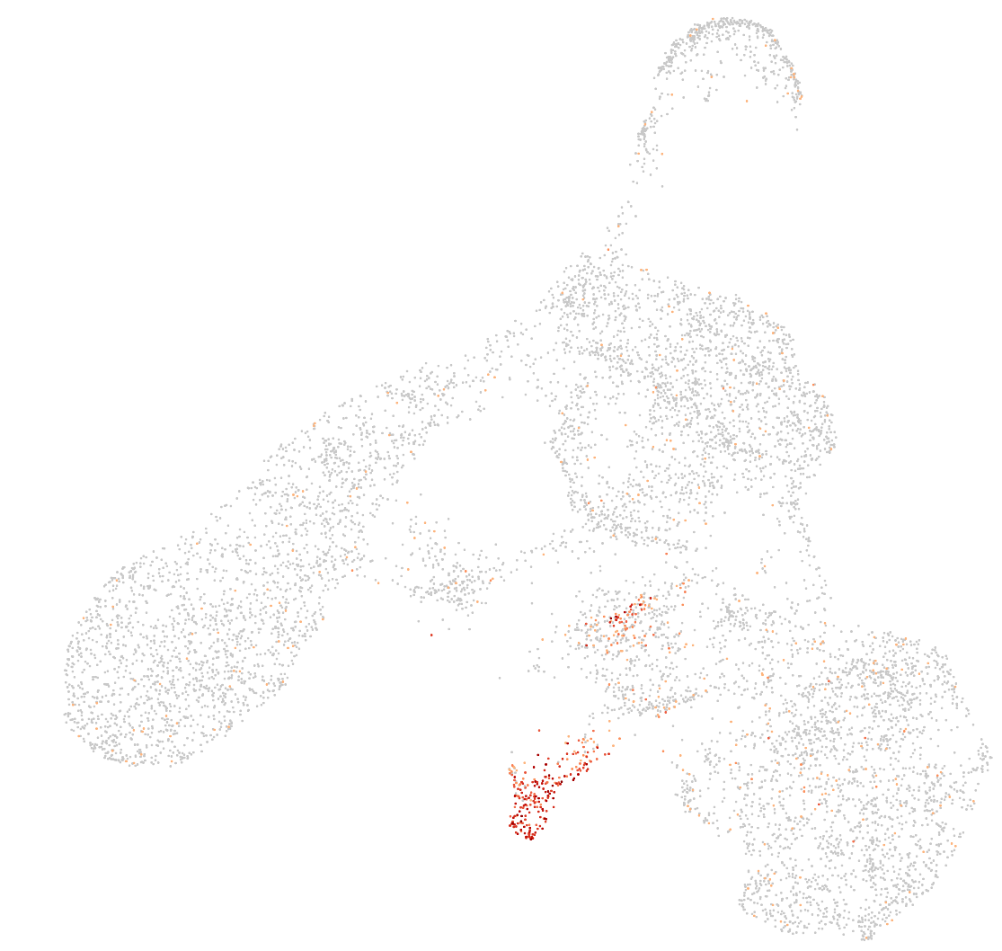
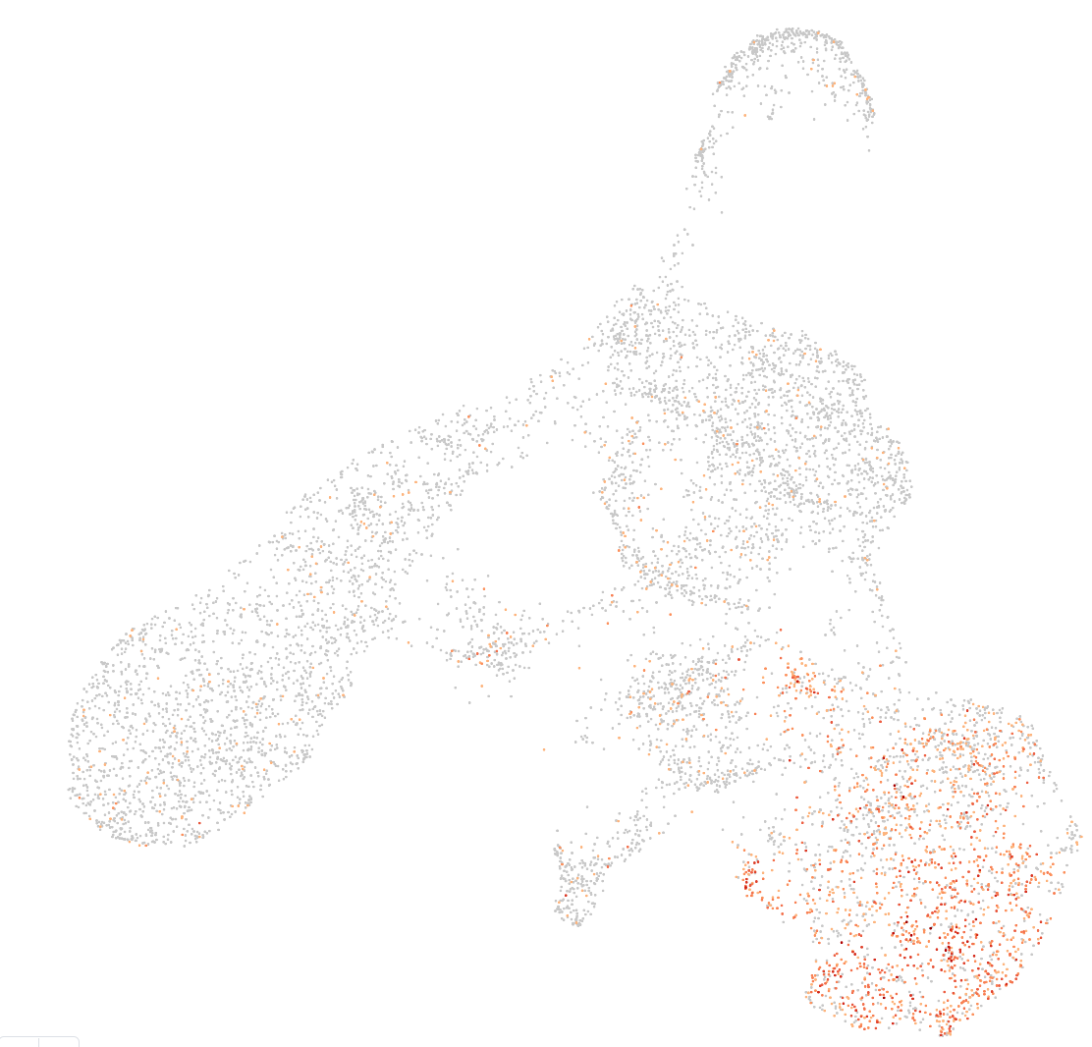
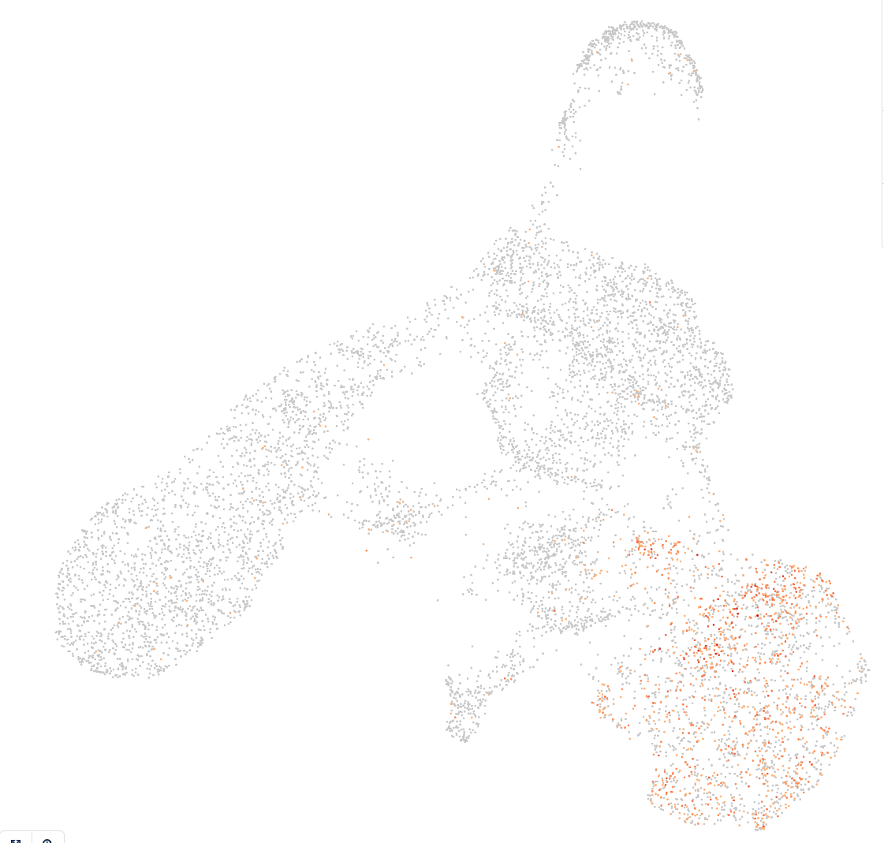
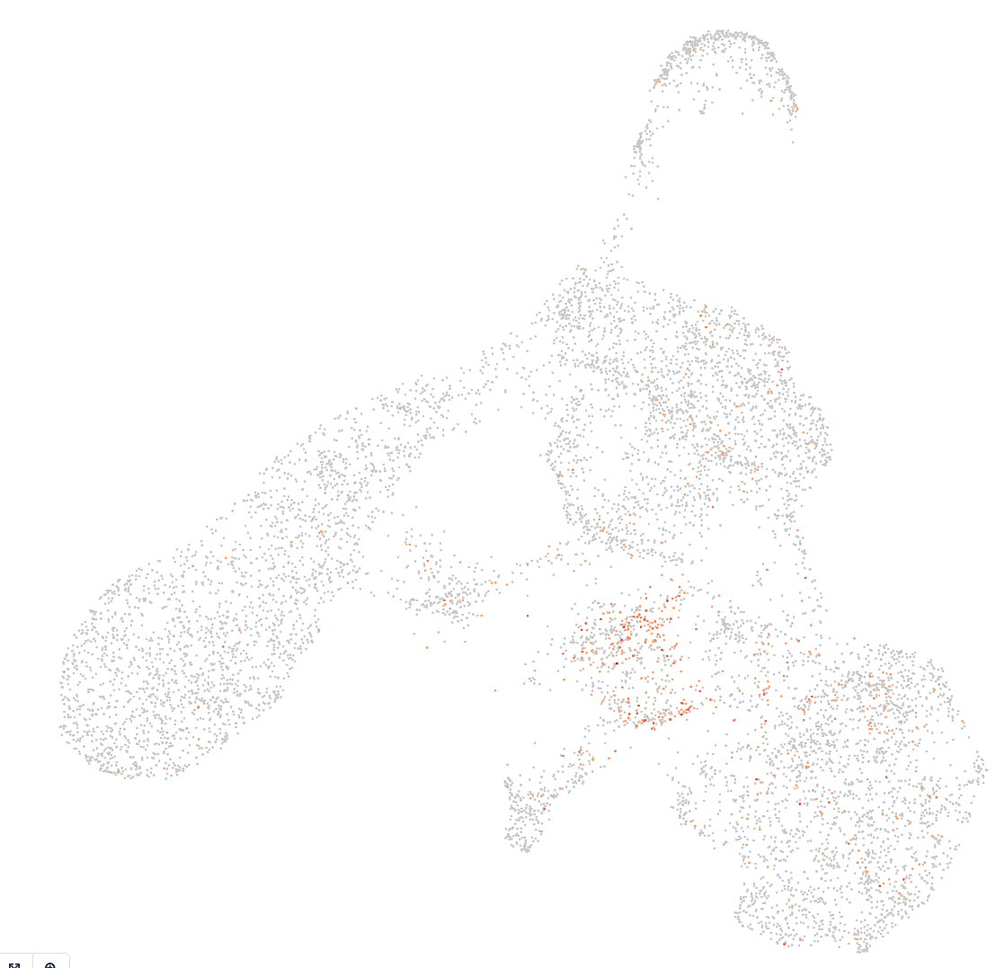
Day22: Initial analysis mucles cells markers
Cluster assignments
PAX3
PAX7
MYOD1
MYOG
OGN
PDGFRA
HEY1
Notes:
Possible cell types: myogenetic progenitors, myoblasts, myocytes, Skeletal mesenchymal, myotube, myofiber
Gene markers described in
Haibin Xi, Justin Langerman, Shan Sabri, Peggie Chien, Courtney S. Young, Shahab Younesi, Michael Hicks, Karen Gonzalez, Wakana Fujiwara, Julia Marzi, Simone Liebscher, Melissa Spencer, Ben Van Handel, Denis Evseenko, Katja Schenke-Layland, Kathrin Plath, April D. Pyle,
A Human Skeletal Muscle Atlas Identifies the Trajectories of Stem and Progenitor Cells across Development and from Human Pluripotent Stem Cells,
Cell Stem Cell,
Volume 27, Issue 1,
2020,
Pages 158-176.e10,
ISSN 1934-5909,
https://doi.org/10.1016/j.stem.2020.04.017.

Slide 12
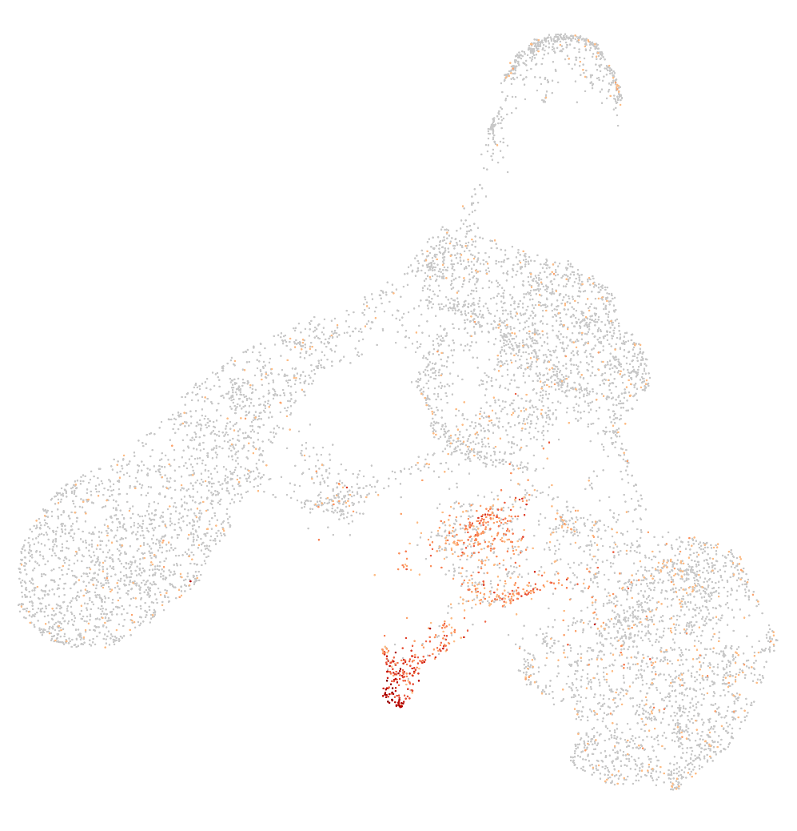
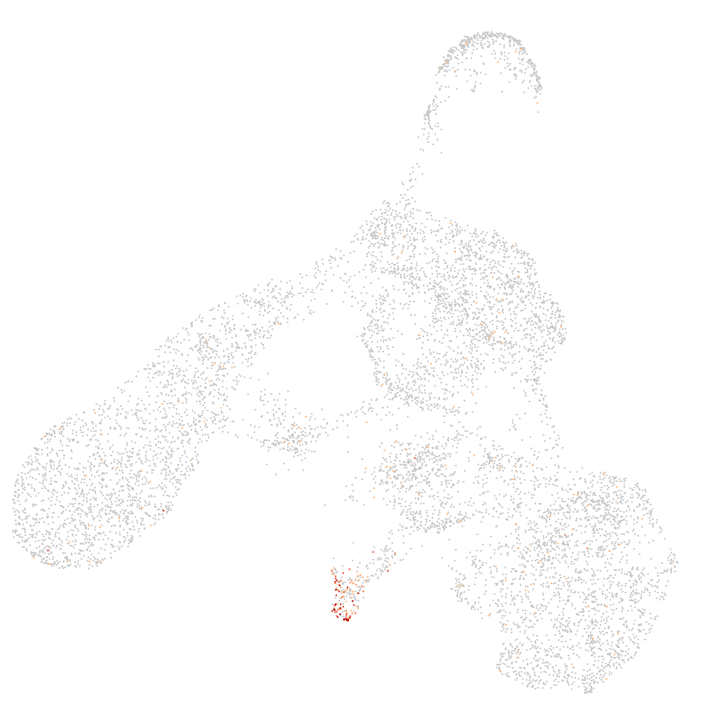
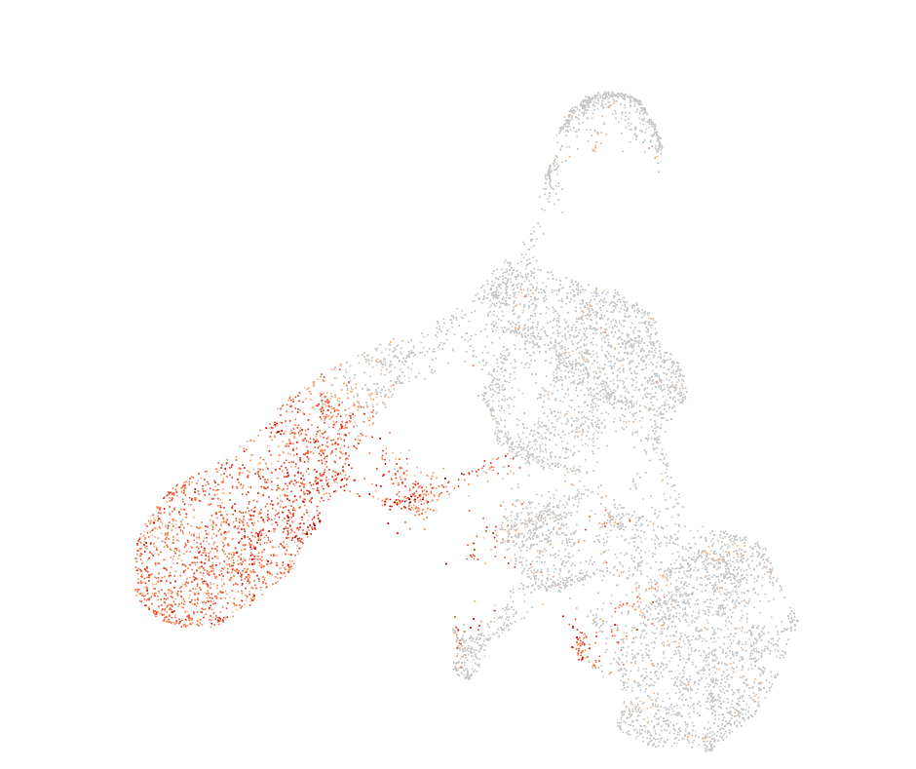
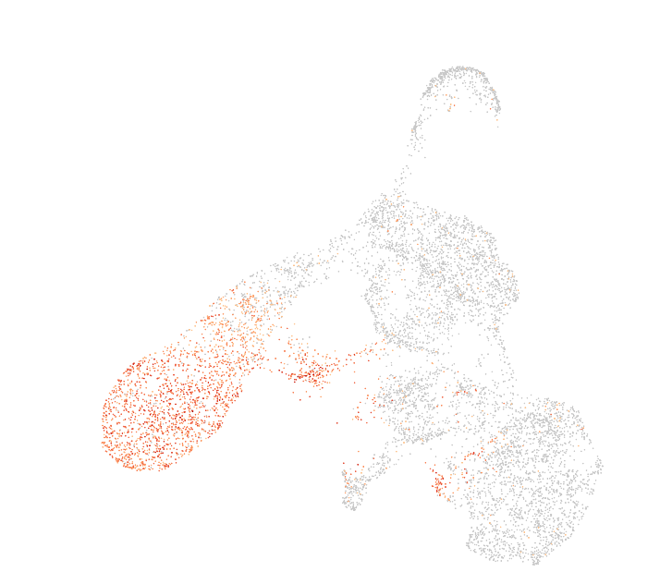
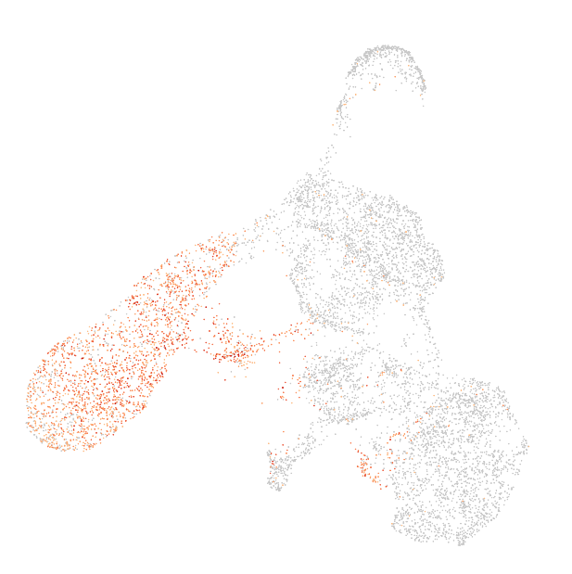
Day22: Initial analysis mucles cells markers
Cluster assignments
CKM
TNNT1
MYT1L
GRIA2
SRRM4
top 3 differently expressed genes
in green cluster
-> associated with neuronal tissues
Notes:
First row more muscle cell markers
Second row top 3 differently expressed gene in green cluster -> associated with neuronal tissues

Slide 13
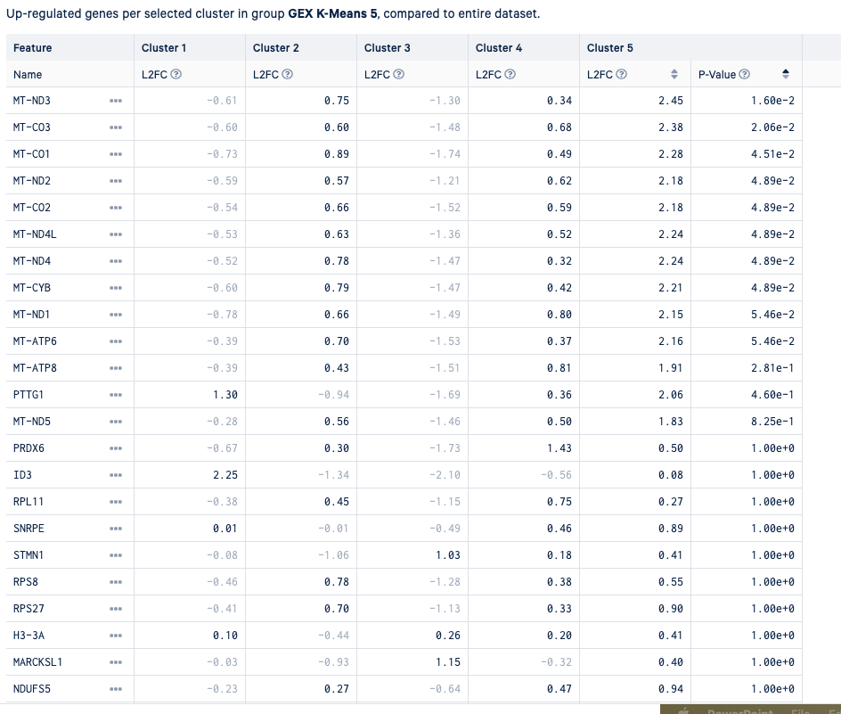
Mitochondrial cell almost all differently expressed genes ->
dead cells?

Slide 14
Day 22
Dead cells
Myogenetic progenitors
Neuronal tissues
Myoblast
Skeletal mesenchymal
Myocytes + myotube

Slide 15
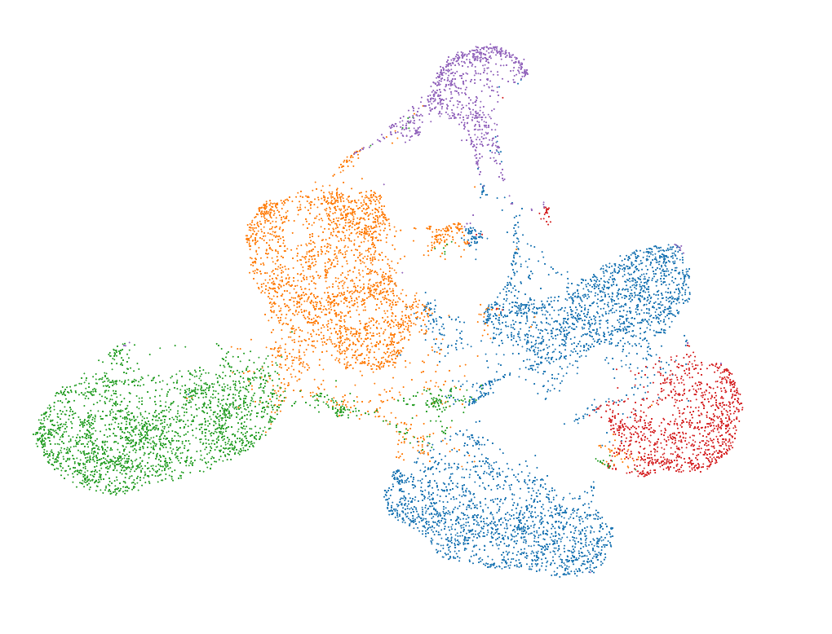
Day 22
RNA UMAP + K-means clustering (k=5)
Notes:
From the 10X pipeline

Slide 16
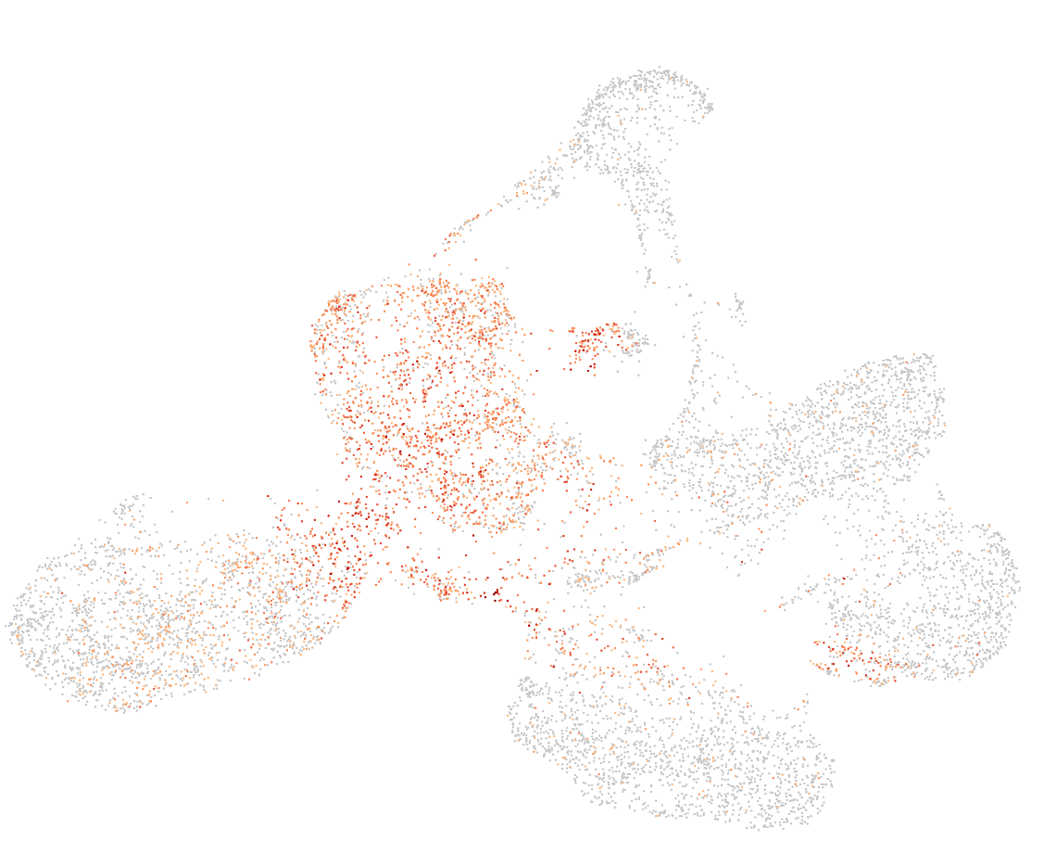
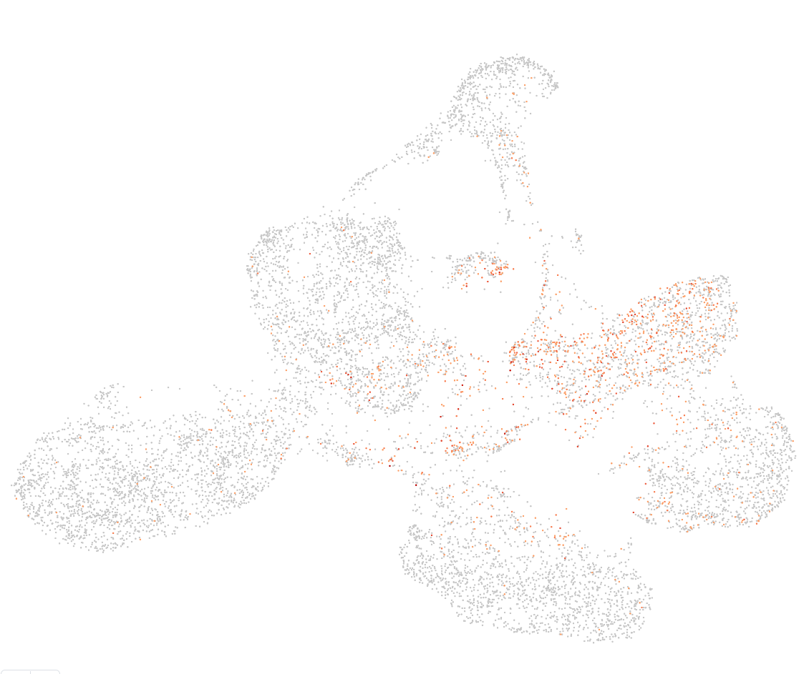
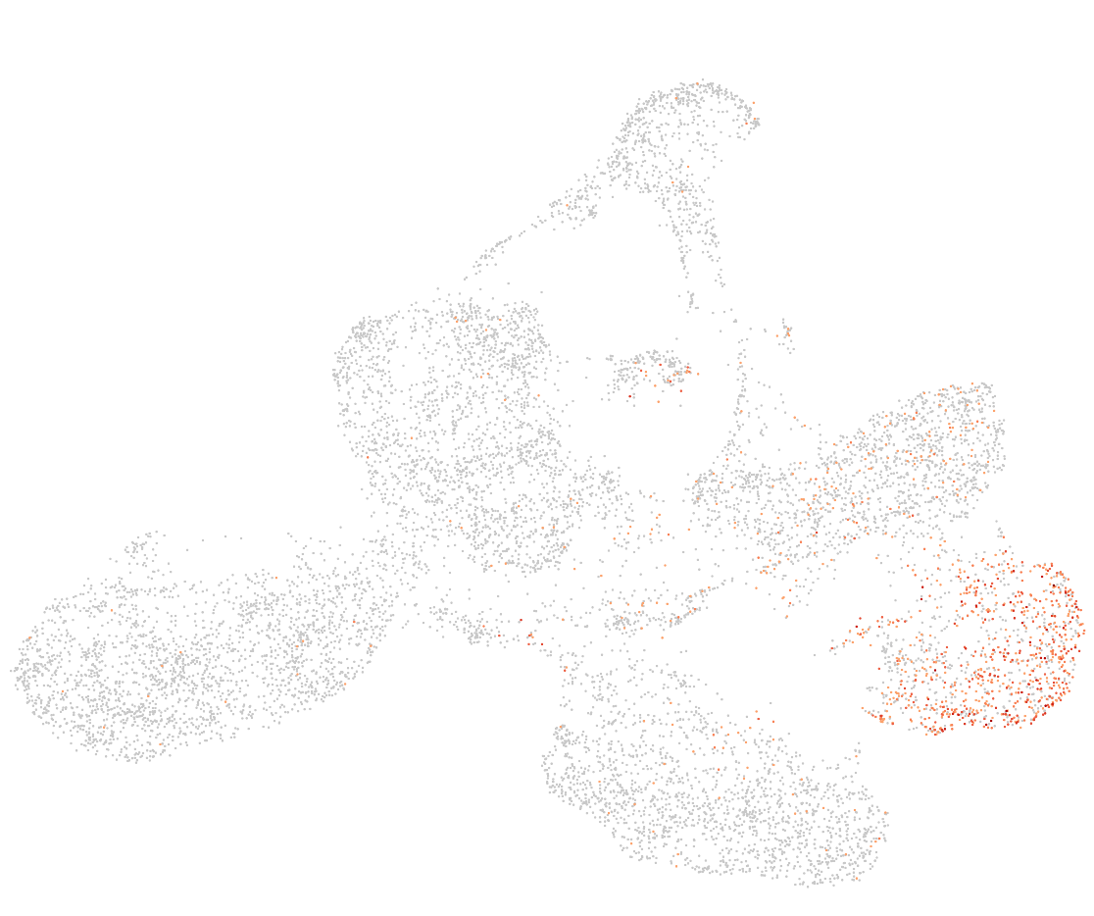
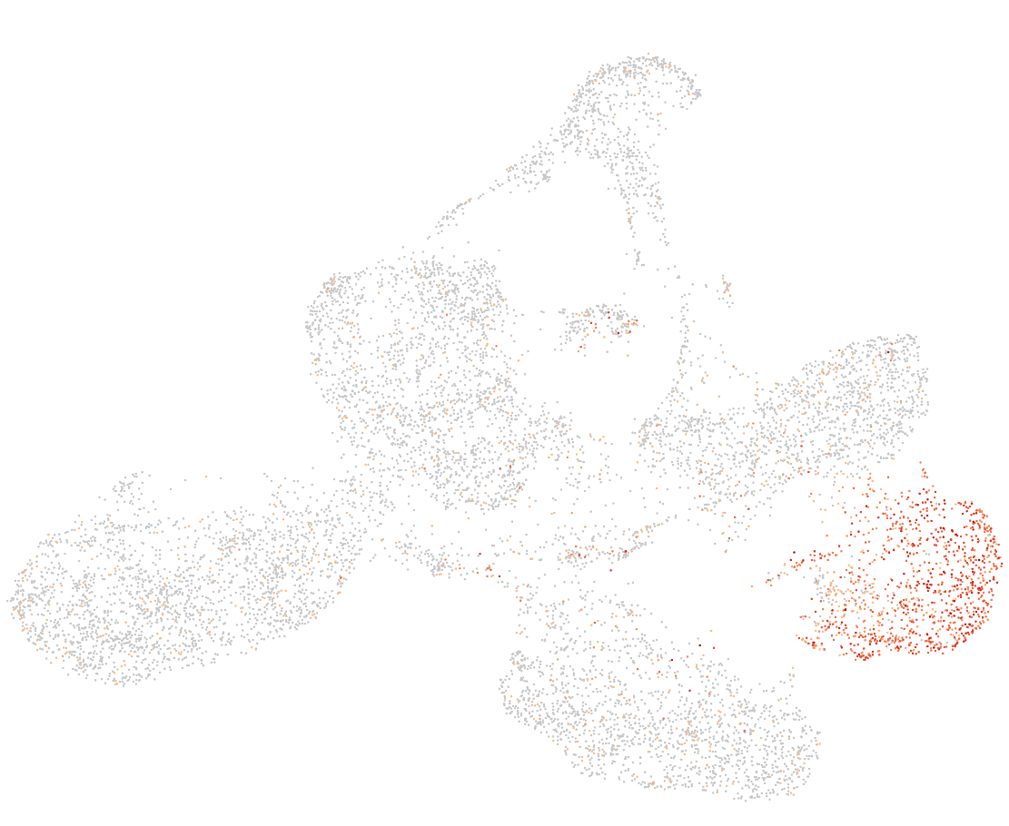
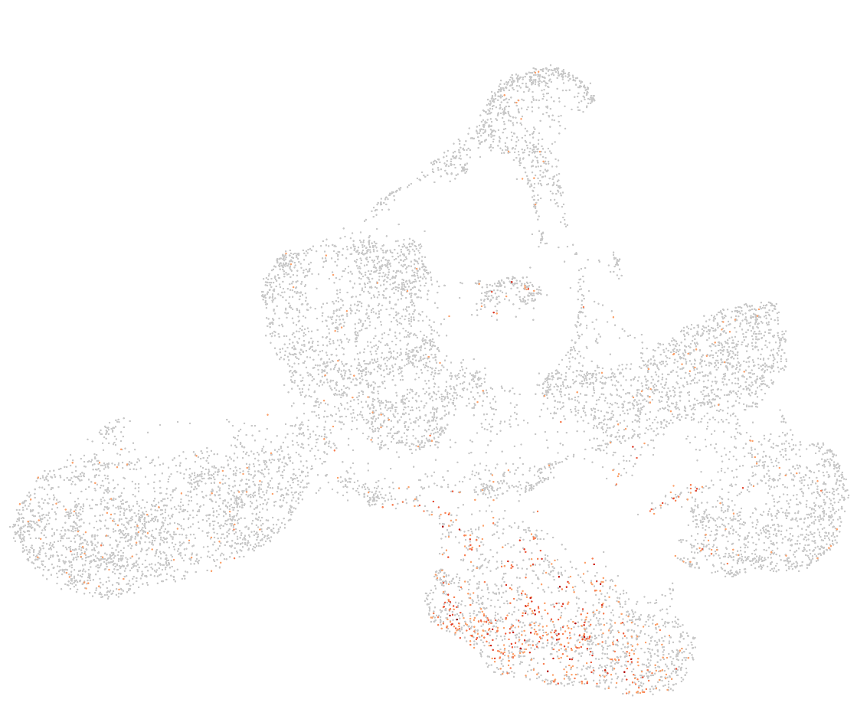
Day12: Initial analysis mucles cells markers
Cluster assignments
PAX3
PAX7
MYOD1
MYOG
OGN
PDGFRA
HEY1
Notes:
No expression of muscle cell markers (PAX7, MYOD1,…), but a bit of the OGN PDGFRA -> messenchymal

Slide 17
Day22: Initial analysis mucles cells markers
Cluster assignments
CKM
TNNT1
MYT1L
GRIA2
SRRM4
top 3 differently expressed genes
in green cluster
-> associated with neuronal tissues
Notes:
First row more muscle cell markers
Second row top 3 differently expressed gene in green cluster -> associated with neuronal tissues

Slide 18
Next
Can I get a better clustering by using Louvain in scanpy pipeline?
Pathway enrichment analysis?
Consistent across replicates?
Look at evolution expression TFs of cut&tag
------------------
Remove cells identified as neuronal tissues?
Use all dataset at same time to do clustering?

